Slide 1
EECS 482
Lab 0: Introduction and Tools

Slide 2
Introduction

Slide 3
Agenda
Administrative Things
Git/GitHub
Makefiles
GDB

Slide 4
Structure of Lab
This lab: synchronous, in-person, not recorded
Asynchronous lab recording will be made available the Monday after
We encourage everyone to attend in-person lab as we have seen that students gain a significantly better understanding of the content
Not required, but helpful for review and project tips
Pre-lab exercises will be posted on the course website, which we will go over during lab
Please attempt before going to lab!
Solutions can be easily verifiable, but hard to construct yourself
We may also do the in-lab exercises together
Slides will be posted, but solutions will be redacted

Slide 5
Piazza
Usually the quickest way for you to get your questions answered
Helps the rest of your classmates too!
Please search for an answer to your question before asking
If you question involves specific design, code, or test cases, it must be private
Other quick resources:
The Spec
Linux Man Pages
Google
Stack Overflow
cppreference
Notes:
8 minute average last semester
Keep questions 482-specific; the internet is a better resource for C++ questions (♥ cppreference.com ♥) A machine answers your Google queries, but a human answers your Piazza posts!

Slide 6
Office Hours
https://oh.eecs.umich.edu/; equivalently, eecs.help
Both in-person and virtual OH offered (up to each IA/GSI)
We will serve both virtual and in-person requests during in-person office hours, but only virtual requests during virtual office hours
[Virtual] Put a Zoom/Google Meet link for the location, and put the password in the description
Read the instructor's message for logistics
Pay attention to your place on the queue
If there is no one in your meeting link when we get to you, you may be popped
Office Hours is a good place to go for:
Project help
Questions about lecture content

Slide 7
Office Hours Continued
EECS 482 queue is for all students, EECS 498-002 queue is for 6-cr students only
We will double Office Hours the week before project is due (for P2-P4)
We will try to empty the queue
Don't expect a direct answer
Come prepared to explain what you've tried already to solve your problem
Test cases you've written
Efforts to find bugs with GDB
In general, we won't tell you how to design your project, find bugs for you, or give you hints on autograder tests.
Help us help you!
Notes:
Don’t expect a direct answer
Don’t be afraid to get a second opinion
Explain what you’ve done so far; the more precise you are, the better we can help

Slide 8
Projects
The bread and butter of EECS 482
Projects 2-4 require a group of 2-3
Projects 2-4 are also graded for style
No formal requirements; just write the best code you can
Use good coding paradigms, avoid code duplication, add good/useful comments
Project 1: 3%
Project 2: 15%
Project 3: 15%
Project 4: 15%

Slide 9
What makes the projects hard?
You develop from scratch
The bugs you will encounter are very tricky/subtle
The specs are long; there are many requirements
You are limited to 1 submit per day (3 bonus submits)
You must thoroughly test your code; the autograder should not be a debugging tool (output isn’t very helpful)
This is a thinking class, not a typing class

Slide 10
Project tips
Start early
Think first, code later
Strive for a good design before writing a single line
Read the spec thoroughly to ensure you cover all bases
Write targeted tests
Incrementally test subsystems before the entire project is complete
Deliberately write tests to break your code
Try shrinking test cases to be more targeted
Avoid premature optimization (this isn’t 281)
Write simple code
Consult Piazza for questions!
Notes:
A thinking course, not a typing course
Shrink test cases -- long output can be hard to read through

Slide 11
Git/GitHub

Slide 12


Git refresher
Remote repo
Local repo
git clone <repo link>
git add <filename>
git commit [-m]
git pull
git push
1. Create local copy
2. Mark changed files
3. Save local changes
4. Accept changes that partners might have made since your last pull
4.5. Merge conflict?
Always pull before you push!
5. Send local changes
Notes:
git status
git branch
git checkout -b

Slide 13
Lifecycle of a file in a git repo
Untracked
Unmodified
Modified
Staged
creation
git add <FILENAME>
edit the file
git add <FILENAME>
git rm --cached <FILENAME>
git commit

Slide 14
Pushing to GitHub without authenticating
Strongly recommend setting up an SSH key so that you can interface with GitHub through the terminal without inputting your password
Instructions:
https://docs.github.com/en/github/authenticating-to-github/connecting-to-github-with-ssh

Slide 15
Git Tip:
This makes it easier to see where a bug may have been introduced.
Commit often with small commits.

Slide 16
Tracking Group Contributions
If we are in doubt about a group’s distribution of work, we reserve the right to check the git commit logs to see who is doing work.
If coding as a group, switch github accounts every so often:
$ git config --get user.name
Manos Kapritsos
$ git config user.name “Advay Muchoor”
$ git config user.email “advaym@umich.edu”

Slide 17
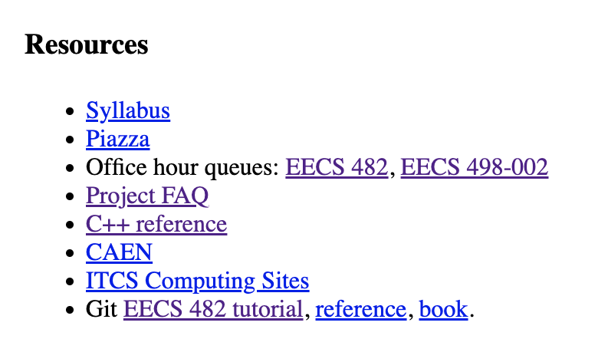
EECS 482 Git/GitHub Tutorial
https://grader4.eecs.umich.edu/eecs482/git-tutorial/

Slide 18
Makefiles

Slide 19
Makefiles
What are they?
Files containing directives to automate compilation and other command-line tasks
Learn this because:
Typing out (or finding in history) g++ scheduler.cpp -o scheduler.exe… is a waste of time and error-prone
They’re really powerful (can implement a personal autograder with them)
They’re ubiquitous

Slide 20
Makefiles: targets/recipes
Makefiles contain a list of targets and their recipes
A recipe is a list of shell commands that are run when make <target> is typed in the terminal
target:
command1
command2
TABs not spaces!

Slide 21
Makefiles: target example
Use a Makefile to easily switch between git users on the same computer
Running make advaym will configure git for me, and make manosk will do the same for Manos Kapritsos
Remember, Makefile recipes needn’t be compilation commands, though they often are
advaym:
git config user.name “Advay Muchoor”
git config user.email advaym@umich.edu
manosk:
git config user.name "Manos Kapritsos”
git config user.email manosk@umich.edu

Slide 22
Makefiles: dependencies
A dependency can be a filename or another target
A target runs if: (a file with the target’s name doesn’t exist) OR (a dependency file has been modified more recently than the target’s file)
A target runs its dependencies’ recipes before its own
target: dep1 dep2
command1
command2
TABs not spaces!

Slide 23
Makefiles: dependency example
# Write sample.txt with contents of depends.txt
sample.txt: depends.txt
cat depends.txt > sample.txt
$ touch depends.txt # create empty file
$ make sample.txt
cat depends.txt > sample.txt
$ make sample.txt
make: ‘sample.txt’ is up to date. # no changes since last make
$ echo “Hello, world!” >> depends.txt # write to depends.txt
$ make sample.txt
cat depends.txt > sample.txt

Slide 24
Makefile Variables
Variables: List of strings Accessed by $(var_name)
FILES = test.txt sample.txt depends.txt
clean:
rm $(FILES)

Slide 25
Making Make More Useful: Wildcards
Just as in the shell, wildcards can be expanded into any combination of characters.
Useful to get all files starting/ending with test
# Get all .cpp files, but not ones that start with test
TESTSOURCES = $(wildcard test*.cpp)
SOURCES = $(filter-out $(TESTSOURCES), $(wildcard *.cpp))
HEADERS = $(wildcard *.h)

Slide 26
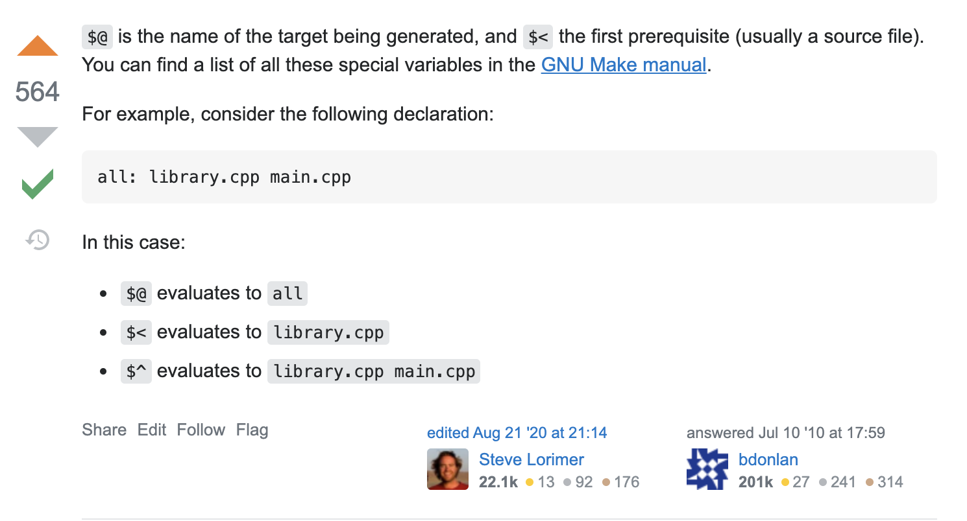
Makefiles: Some more shortcuts

Slide 27
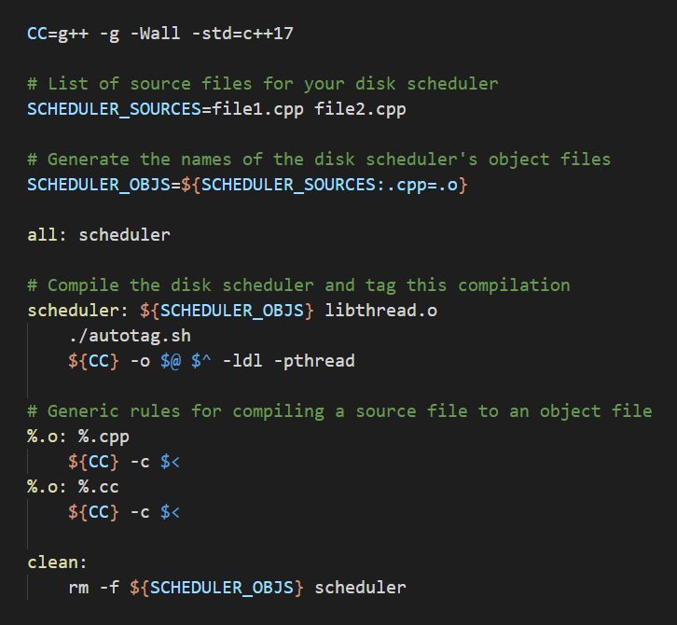
Project 1 Makefile
Provided for you
You can modify it (and the Makefiles for other projects) to facilitate running your test cases

Slide 28
GDB

Slide 29
GDB and core dumps
What are they?
GDB is a command-line debugger available on CAEN. (LLDB is basically the same thing on Mac)
Core dumps/memory dumps are a snapshot of a program’s state, usually taken just as the program crashed. YOU CAN SEE WHAT HAPPENED DURING THE CRASH (and usually figure out why!)
Learn this because:
GDB is ubiquitous. On any system, even if it’s infeasible to hook in with the VS or Xcode debugger, you’ll have GDB.
Staff are all familiar with GDB.
Core dumps give you a way to debug non-deterministic (i.e. hard to reproduce) bugs in your code.

Slide 30
GDB: basic usage
Compile your code with debugging symbols (i.e. with -g, or -g3)
Load the executable into GDB:
$ gdb ./your_project.exe
Set breakpoints on lines you want to inspect.
gdb> break foo.cpp:25
gdb> break main()
gdb> break 25
gdb> break MyClass::bar
Run the executable.
gdb> run
gdb> run --arg 0.3 > output
gdb> r 0.3 > output
Wait for the executable to break (on a breakpoint, or by hitting CTRL-C).
Inspect what’s going on.
gdb> bt
gdb> p my_var
gdb> list
gdb> next
gdb> continue
Notes:
Most of these slides are here for completeness, so that you can view them from the public slides folder, not so that you can study them right now.
Note that you can pass arguments to run on the command line.

Slide 31
GDB: basic command cheatsheet
b location (set breakpoint)
b main()
b main.cpp:12
b MyClass::~MyClass()
dis n (disable breakpoint n)
dis <breakpoint_num>
en n (enable breakpoint n)
del n (delete breakpoint n)
r args (run or restart)
r --num_cpus 4
kill (kill)
s n (step n times)
Steps into functions
n n (next n times)
Steps over functions
c (continue)
Continue until end or next breakpoint

Slide 32
GDB: basic command cheatsheet
p expr (print)
Print value of variable or expression
Works on pretty much anything
i topic (info)
i b (list breakpoints)
i thr (list threads)
f (frame)
View current line
list (list code)
View nearby code lines
bt (backtrace)
View the call stack
up n (up n frames)
less recent frames
down n (down n frames)
More recent frames
thr n (switch to thread n)
thr 3

Slide 33
Pro Tip: Conditional breakpoints!
cond n expr
Sets a condition on breakpoint n
If no expr, gets rid of the condition for breakpoint n
Example for a for loop:
(gdb) $ cond 1 (i >= 4)
Notes:
Forever demo
Make forever
Gdb forever
Breakpoint at the line after the for loop
Do a few iterations
Kill
Cond 1 i==1400
r
P i

Slide 34
Pro Tip: Automatic breakpoint commands!
Allow you to perform specific actions every time a breakpoint is hit.
Example: run executable until it seg faults.
(gdb) $ set pagination off
(gdb) $ break _exit
(gdb) $ commands
> run
> end
https://stackoverflow.com/questions/6545763/how-can-i-rerun-a-program-with-gdb-until-a-segmentation-fault-occurs/6546674
Notes:
Forever demo
Make forever
Gdb forever
Breakpoint at the line after the for loop
Do a few iterations
Kill
Cond 1 i==1400
r
P i

Slide 35
Core dumps
Core dumps are files created when a program crashes, populated with the state of the program’s memory at the instant the crash occurred.
Usually named something like core or core.12345, where 12345 was the Process ID (PID) of the program you ran.
Instead of running a program in GDB, you can tell GDB to load your core dump
When viewing a core dump, you can do everything you can normally do in GDB that doesn’t involve running the program (e.g. step, next, etc.)

Slide 36
Creating core dumps
Create core dumps by running:
$ ulimit -c unlimited
$ ./your_program.exe
Segmentation fault (core dumped)
View core dumps in GDB by running:
$ gdb ./your_program.exe -c core.12345
Core dumps can be created in a variety of locations; Google your OS to figure it out;
/var/lib/systemd/coredump on CAEN
Note that your program needs to crash to produce a core dump.
An easy way to ensure this is with assert() statements.

Slide 37
Full GDB cheat sheet
http://users.ece.utexas.edu/~adnan/gdb-refcard.pdf

Slide 38
GDB Exercise
https://github.com/eecs482/gdb_demo
Notes:
The recorded lab will include a walkthrough of this exercise. If there is time in lab, in person instructors should also do a quick walkthrough of using GDB

Slide 39
Questions?

